Slide 1
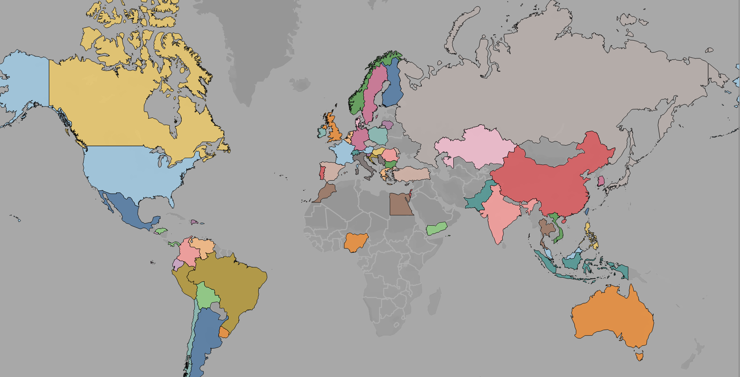
Analysis ON Wish E-commerce data (2020 and 2021)
Presented by Team 1:
Harpreet Kaur
Krishna Patel
Wali Rehman
Ankit Sahu

Slide 2

Index
About the Wish Platform
About the Dataset
Objective
Benefits of our project
Data Wrangling
Merging Dataset
Getting to know merged data
Data Formatting
Handling missing values
Accuracy Check
Check for duplicate values
Data visualization
Summary

Slide 3

About Wish PLATFORM
Wish is one of the largest e-commerce platform that lets users sell and buy all sorts of products.
Founded in San Francisco in 2010 and is now active in 69 countries.
They are selling a huge variety of affordable products to consumers all over the world
69 Global presence
34,882 Merchants registered
96,045 Total products

Slide 4
About the Dataset
For our project we will be using E-commerce product sold historical data of 2020 and 2021. The uncleaned dataset is obtained from Kaggle.
The purpose of our project is to determine top selling product category, size and color.
Product attributes like price, discount, size , color and rating to be used for analysis
Niche and Mainstream files contains over 315 product category files. Furthermore, some files are related to product ratings and performances

Slide 5
About the Dataset
Variables | Description
Title | Product name of each product category
Discount Price | It contains the discount price of each product
Discount Price currency | Currency of discount price
Rating counts | How much rating the customer has given to product from 5
Product color | It contains color of the product
Product size | Size of the products like Small, Medium, large
Retail Price | Price at which product is sold to customer
Retail Currency | Currency of retail price
Quantity | How many quantity of product have been sold out
Product Id | Id of each product
Product Category | A product category is a group of similar products that share related characteristics.
Order Date | When the product was ordered

Slide 6

Objective
The goal of this project is to create a dashboard for Wish E-commerce executives so that they can have an overview/analyze/report on their business, with a focus on sales, inventory, and product features such as size, color, and rating for year 2020 and 2021.

Slide 7
BENEFITS of OUR Project
Boost the product
How to improve sales
Improving global presence

Slide 8
Merging Dataset
No of Files | 315
No of records in each file | 700-1500
Type of files | Niche and Mainstream types
How are we merging | Using for loop and creating new Product Name variable to uniquely identify the records.

Slide 9
Getting to know the Merged data
For merged dataset
Number of rows | 2,80,011
Number of columns | 45
Number of Numerical columns | 28
Number of Categorical columns | 17

Slide 10
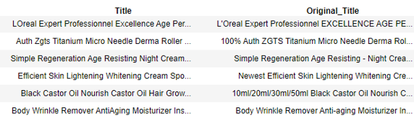
Data Formatting
Converting column names to appropriate names by renaming them.
Formatting the title by removing unnecessary words from the string.
Date column was formatted.

Slide 11
HANDLING MISSING VALUES
Removal of columns where all the values are missing. (10 columns)
Replacing missing values
Removed records having more than 70% of data missing values using the missing_value function (29319 records)

Slide 12
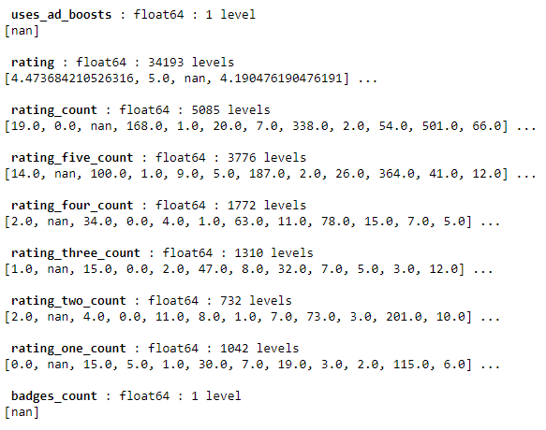
HANDLING MISSING VALUES

Slide 13

Accuracy Check
Histograms for numerical variables
Bar chart for categorical variables
Statistical Summary
Removal of outliers
Duplicate value check

Slide 14
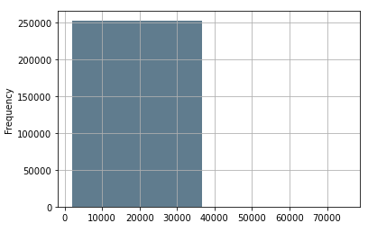
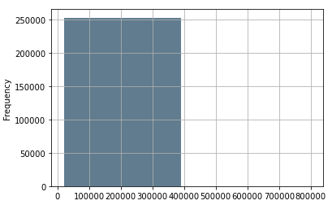
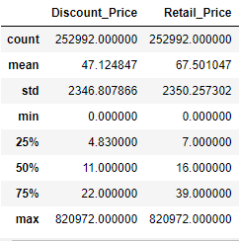
HISTOGRAM FOR NUMERICAL VARIABLES
Statistical Summary
Discount_price
Retail_price

Slide 15
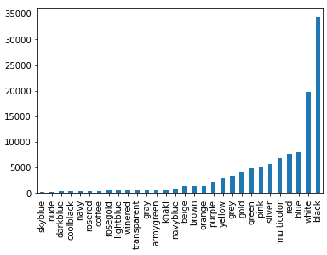
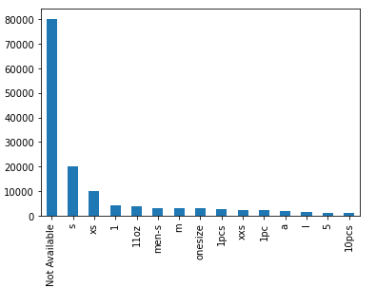
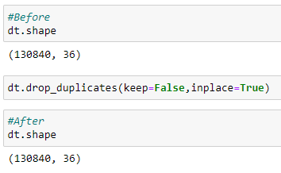
BAR CHART FOR CATEGORICAL VARIABLES & CHECK FOR DUPLICATE
Product_color
Product_size
Duplicate value check

Slide 16
GETTING DATA READY FOR VISUALIZATION
Rearranging columns
Dropping unused columns
Added measures
Fuzzy word match
Final Dataset
Number of observation | 132,105
Number of variables | 35

Slide 17

Data Visualization

Slide 18
SUMMARY
For 2020 and 2021, the Wish platform had 96,045 unique products sold by 34,822 different merchants across more than 69 countries.
Majority of merchants and products are from China.
Overall, the month of September and October in 2020 and 2021 generated the most revenue. In both years, jewels were in high demand. In addition, clothing in small sizes and dual colors were highly sold.
As our application demonstrates, there is a link between product color/size and rating. The product selling strategies can be made based on the features as well as region.

Slide 19
THANK YOU

